Slide 1

Experiential Learning – World CafE
Amy Scholl, Au and Associates, July 2016

Slide 2
What is Experiential Learning?
In the words of Lewis and Williams (1994, p.5): “In its simplest form, experiential learning means learning from experience or learning by doing. Experiential education first immerses learners in an experience and then encourages reflection about the experience to develop new skills, new attitudes, or new ways of thinking.”

Slide 3
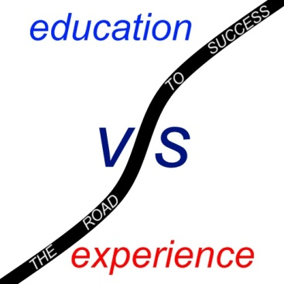
Let’s Expand that Definition
Compartmentalized learning doesn’t reflect the real world, whereas the experiential classroom works to create an interdisciplinary learning experience that mimics real world learning (Wurdinger, 2005, p. 24).

Slide 4
Criteria for EL
Chapman et al. suggest an activity or method should be:
Mixture of content and process: There must be a balance between the experiential activities and the underlying content or theory.
Encouraging the big picture perspective: Experiential activities must allow the students to make connections between the learning they are doing and the world. Activities should build in students the ability see relationships in complex systems and find a way to work within them.

Slide 5
Students Who benefit
The mature learner who has been long removed from the traditional classroom and needs the motivation of contextual learning to get them back into the swing of academia.
The learner who needs to personally experience the value of a subject in order to be motivated to learn.
The learner who has trouble learning within the formal classroom, and needs an alternate learning method in order to succeed.
Any learner who can benefit from having hands-on examples to bolster their traditional learning (Cantor, 1995, p. 80).

Slide 6
Types of experiential Learning
Field-based learning is the oldest and most established form of experiential learning, having been integrated into higher education in the 1930s.
Classroom-based experiential learning can take a multitude of forms, including role-playing, games, case studies, simulations, presentations, and various types of group work.

Slide 7

Let’s share our own experiences
In a roundtable discussion, we’ll share one successful experiential learning experience.
We’ll discuss our comfort level with experiential learning.
We’ll problem-solve the challenges and roadblocks with the methodology.
We’ll acknowledge the benefits.

Slide 8

CREATE THE Ultimate experience
In groups of 4 or 5, your challenge is to develop the ULTIMATE experiential learning experience for an agreed upon English class.
Please establish a learning goal or content that you’ll reinforce through the experience. Then, plan the experience in detail.
You’ll have 15 minutes to complete this task and then you’ll present this to the group.

Slide 9

Thank YOU!
Thank you for sharing your ideas with the group! I know we all benefit from them.
Let’s open it up for a question and answer session.

