Slide 1

Questioning: the Key to classroom Discussion
Literal, Inferential, and Evaluative Questions

Slide 2
Who does the asking?
In many classrooms around the world, the teachers do the questioning. Students ANSWER questions; they do not ASK them.
But if question-asking is the key to learning, who should do most of the asking?
How do we create a classroom where students ask most of the questions?

Slide 3

MINDS ON!
Gallery walk with sticky notes: walk around the class and read each text (pictures can be texts too!) At each text, consider it, and ask ONE question about it. Write your question on a sticky note. Then, move to the next text.

Slide 4

ACTION!
The teacher will model a read-aloud and think-aloud of a news article about a potential UFO abduction.
She will introduce THREE kinds of questions that will help promote different kinds of thinking.

Slide 5

Literal Question
The answers to literal questions can be found directly stated in the text. We sometimes say this information is on the surface.
Why do we ask literal questions?

Slide 6

Inferential Question
The answers to inferential questions can be found in the text too, but they are implied, not directly stated. We often say the information is in between the lines or under the surface. Students use textual clues and their prior knowledge to answer these questions.

Slide 7
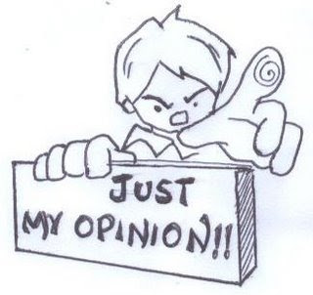
Evaluative Question
The answers to evaluative questions require information outside of the text. We sometimes say the information is in the head or somewhere else. Students will often state their opinion in response to an evaluative question. They will then use textual support and examples from their lives to support their response.

Slide 8
Advance with English
Let’s categorize these questions:
Which city does Justin Foster live in?
What did Justin do with friends last Friday?
What time did Justin get back home that night?
What does Kelly think happened to her brother?
What colour are the aliens according to Kelly?
What happened to Mrs. Mavis Wood?
What do the police think about the incident?

Slide 9

Yeti & Bigfoot?
Now you try asking each type of question about the informational reading “Yeti, Bigfoot and the Wild Man of Shennongjia”.
Later you will ask a partner your questions!

Slide 10
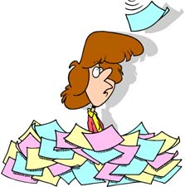
Consolidation: Sorting
In a group of 2 or 3, choose one of the texts from the start of class (one group per text), and start sorting the questions into the categories. Physically move the stickies into the graphic organizer.
Once the questions are organized, use them to stimulate a small group discussion.

