Slide 1
Dealing with
Difficult People & Difficult Interactions
Dr. Brinkman and Dr. Kirschner
& Harvard Business Press

Slide 2
What are the 10 most common unwanted behaviours in the workplace?
The Tank
The Sniper
The Grenade
The-Know-It-All
The Think-They-Know-It-All
The Yes Person
The Maybe Person
The Nothing Person
The No Person
The Whiner

Slide 3
It is important to understand:
Everybody reacts differently to these types of behaviours
What part you play
That you must choose your approach and leadership style carefully!

Slide 4
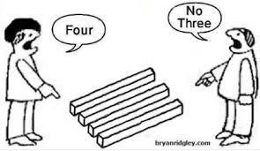
What is a difficult interaction?
Disagreement

Slide 5
What causes a difficult interaction?
Differences in:
Positions
Interests
Perceptions
Motivation
Styles ( learning, work, communication)
Life experiences
Cultural Backgrounds

Slide 6

How do you handle a difficult interaction?

Slide 7
Wait!
Stop and take a breath.
Look at the situation from different angles
Are you part of the problem?
What is your motivation?
Are these important relationships?
Is there a good chance of improvement?
Is it your job?

Slide 8
You cannot change people…but you CAN:
Try to listen and understand them
Find common ground
Build on their strengths
Communicate
Manage the situation
Manage the people
Have a courageous conversation

Slide 9
Activity
Role Play – courageous conversations with difficult people

Slide 10
Questions
&
Next Steps

