Slide 1

Assessment and Evaluation
How are we using it to improve student learning?

Slide 2

Assessment and Evaluation – An Inventory of Teacher Beliefs
CROSS THE LINE
I believe I have power/control over the assessments I give in my classroom.
I believe that assessments improve student learning.
I believe that assessments don’t always accurately measure what students are capable of.
I believe that students always read my comments and use them to improve their work.
Notes:
15 - 20 mins

Slide 3
Assessment and Evaluation – An Inventory of Teacher Beliefs
CROSS THE LINE
I always do a diagnostic assessment before I introduce a new skill or concept.
I regularly incorporate opportunities to assess my students before the test/exam/presentation.
We (as a department or team of teachers) plan our own formative and summative assessments.
I feel my students are well-prepared for final exams.
Notes:
15 - 20 mins

Slide 4

LET’S THINK DEEPLY ABOUT ASSESSMENT AND EVALUATION!
In your groups, use chart paper to respond to the following prompt. You have 5 minutes.
Write your definition of assessment. Consider how you grade, give feedback, use data, categorize students, and share data/feedback with students.
Notes:
5 mins

Slide 5
LET’S THINK DEEPLY ABOUT ASSESSMENT AND EVALUATION!
In your groups, add to your work with a different coloured marker.
Expand your definition of assessment. List all the ways you assess your students. Consider assessments that don’t have numerical data attached to them. Which ones help you and which ones help your students? Which ones do you value most and why?
Notes:
5 mins

Slide 6
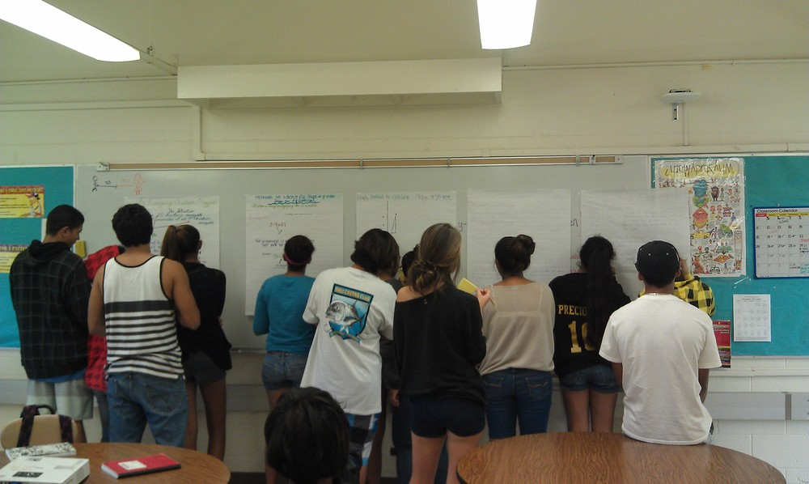
GALLERY WALK & FEEDBACK/COMMENTS
POST YOUR THINKING AROUND THE ROOM.
WALK AROUND THE ROOM WITH A PEN OR MARKER, READ WHAT OTHERS HAVE WRITTEN, AND COMMENT ON THEIR THINKING.
YOU MAY AGREE OR DISAGREE, POLITELY CHALLENGE, QUESTION, CONNECT, OR NOTE SOMETHING YOU HADN’T PREVIOUSLY CONSIDERED.
AT THE END, GO BACK TO YOUR OWN DEFINITION AND READ YOUR COLLEAGUES’ COMMENTS. CONSIDER HOW THEIR IDEAS COMPARE TO YOURS.
Notes:
10 mins gallery walk – 5 - debrief

Slide 7

Formative Assessment
Assessment we all have some control over!

Slide 8
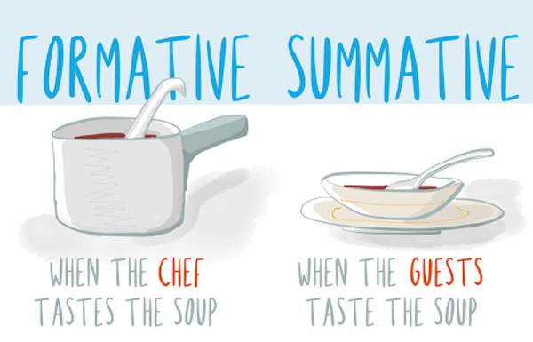
THE POWER OF FORMATIVE ASSESSMENT IN STUDENT LEARNING
Notes:
Ask teachers to consider the image. What happens when a chef tastes the soup? What happens when the guests taste the soup? What power does the formative assessment hold in teaching and learning?
5 mins

Slide 9
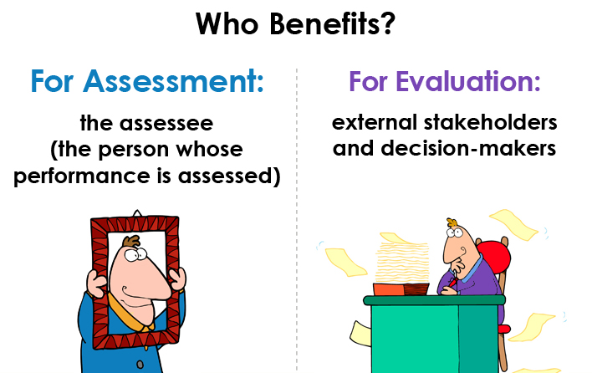
FORMATIVE VERSUS SUMMATIVE: WHO BENEFITS?
Notes:
2 min

Slide 10

FORMATIVE VERSUS SUMMATIVE: A Sorting Activity
Qualities of Formative Assessments | Qualities of Summative Assessments
Cris Tovani, So What Do They Really Know? Assessment that Informs Teaching and Learning, p.14, 2011
Notes:
15 mins – an activity

Slide 11
FORMATIVE VERSUS SUMMATIVE
Qualities of Formative Assessments | Qualities of Summative Assessments
Along-the-way, everyday instructional practice | At the end, after learning has occurred, with no chance to redo
Daily practice toward a product | Product only
Immediate feedback for the teacher and the learner | Feedback for both the teacher and learner often delayed
Informs the teacher and the learner so instruction and practice can be adjusted the next day | Informs future instruction and course design
Focuses on the task; geared toward understanding | Focuses on the individual’s mastery of information at a specific point in time
Allows assessor to get and give immediate feedback to improve student achievement | Frequently used as a way to sift and sort students for course placement
Cris Tovani, So What Do They Really Know? Assessment that Informs Teaching and Learning, p.14, 2011
Notes:
15 mins – an activity

Slide 12

FORMATIVE ASSESSMENT = HOPE
Formative assessments nurture hope and say to students, “You might not get this yet, but you will. Here is something else you can try that might help you understand and improve.”
- Cris Tovani, So What Do They Really Know? Assessment that Informs Teaching and Learning, p. 13
Notes:
THIS IS 65 MIN.

Slide 13
Formative Assessment and Descriptive Feedback = A WINNING Combination
Using success criteria and descriptive feedback in the writing process…

Slide 14

LEARNING GOALS
To understand how to use learning goals and success criteria to support student learning
To describe how to strategically use feedback to support students’ writing
To explore ways to assess and provide targeted instruction related to student needs
Please note: information in the following slides is adapted from the series “Supporting Adolescent Writers” from the Ontario Ministry of Education.
Notes:
1 min

Slide 15

If we hold the following statement true…
We count on students to express their thinking and demonstrate their understanding in a number of ways, including writing.
Then we must TEACH the writing skills and processes that students need to express themselves clearly!
Notes:
1 min

Slide 16

WHEN WE WRITE, WE…
Writing Skills required in school and daily life:
develop a main idea with specific supporting details
organize information and ideas in a coherent manner
use conventions (syntax, spelling, grammar and punctuation) in a manner that does not distract from clear communication
Notes:
1 min

Slide 17
BUT: When we assess, we should narrow our focus!
Teachers believe that it is best to focus feedback on specific errors or feedback for a specific purpose, BUT they mark errors comprehensively.
Lee, 2009, as summarized in Research Snapshots (1), Learning Forward Ontario
Writing Skills required in school and daily life:
develop a main idea with specific supporting details
organize information and ideas in a coherent manner
use conventions (syntax, spelling, grammar and punctuation) in a manner that does not distract from clear communication
Notes:
We’re going to focus on the top two for this exercise. Slide is animated so that at the click of a button, we’re only looking at the top two skills.
Explain that we need to communicate these to students BEFORE they write. These are learning goals! Let’s see what that looks like…
2 min

Slide 18
STRATEGIC PLANNING OF WRITING ASSIGNMENTS = MORE SUCCESS FOR STUDENTS!
Where am I going?
How am I going?
Where to next?
Learning Goals & Success Criteria
Notes:
1 min – go over the difference between formative and summative here – we’ll focus on the first two since they’re formative

Slide 19

PAIR QUESTIONS WITH LEARNING GOALS
QUESTION:
Where would you like to move if you could choose a place to move to? Explain why with specific details.
LEARNING GOALS:
develop a main idea with specific supporting details
organize information and ideas in a coherent manner
YOU’LL EXPLAIN TO YOUR STUDENTS THAT WHEN ASSESSING, YOU’LL BE LOOKING TO SEE THAT THEY MET THE LEARNING GOALS!
Notes:
1 min
Note that in the senior 10, unit two handbook the question is: where would you like to move if you could choose a place to move to? Why?
Perhaps it’s worthwhile mentioning that we should explicitly teach what WHY is asking… perhaps they’d consider trying the version on the slide and seeing if it yielded different results?

Slide 20

NEXT YOU’LL NEED TO ESTABLISH SUCCESS CRITERIA FOR YOUR LEARNING GOALS
Let’s see if we can sort the success criteria in your group’s envelopes into the following categories and subcategories:
Learning goals
develop a main idea with specific supporting details
organize information and ideas in a coherent manner
Other
After sorting: To what categories do the other criteria belong? Are we missing criteria for our two learning goals? How do you create criteria with or for your class?
Notes:
10 mins

Slide 21

LET’S LOOK AT SOME STUDENT WRITING & SORT IT BASED ON OUR SUCCESS CRITERIA!
The following assignment was given to a class of students:
Prompt
Identify a piece of technology or an app that you use on a regular basis. Use specific details to explain how you use it.
Learning Goals:
develop one main idea and support it by using specific details and relevant information - so stay on topic and use information that will help a reader understand what you know about the topic
write one paragraph and organize information and ideas in a coherent manner
Notes:
1 min

Slide 22
WRITING SORT ACTIVITY!
Look at the 4 examples of student writing in your groups. How would you rank them from lower to higher level of quality? Also, decide, based on the success criteria, what each example has and what it’s missing.
JP CT LB KB
Lower level of quality based on the learning goals and the success criteria
Higher level of quality based on the learning goals and the success criteria
Notes:
10 mins
There is an animation here of the answers.

Slide 23
NOW WE GIVE DESCRIPTIVE FEEDBACK AS PART OF FORMATIVE ASSESSMENT TO TELL STUDENTS HOW TO GET WHERE THEY’RE GOING…
Where am I going?
How am I going?
Where to next?
Learning Goals & Success Criteria
Descriptive Feedback
Notes:
1 min

Slide 24

IS THIS DESCRIPTIVE? WHY?
Good work so far. Add more!
Add more details about how you use the app. For example, "I use the app to play with my friends because it's a multiplayer game.”
Choose a focus
One strategy to come up with an effective closing is to review your topic sentence and to see if there is something to build on given the supporting details you’ve used
As a way to generate some anecdotes, describe 2+ experiences (with your chosen app) and then highlight information that shows how it’s useful
Did you have lots of details in your pre-writing? How did you select which details to include?
Notes:
5 min

Slide 25
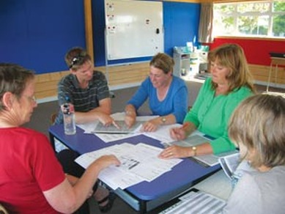
HOW WOULD YOU PROVIDE FEEDBACK?
Based on the learning goals and success criteria, what feedback would you give to the students to help them improve?
Work with your group to provide a list of potential comments for the piece of writing assigned to you. Be prepared to present your findings to your colleagues!
Notes:
10 – 15 min

Slide 26
HERE ARE SOME EXAMPLES FROM TEACHERS IN ONTARIO: WHAT DO YOU NOTICE ABOUT THESE?
Adding supporting details helps your readers understand your topic. You didn’t include any supporting details. One detail you could include is “This app is a game, and I play it in my spare time.” What might be some other details related to your topic (e.g., how you use the app) you could include?
Visualize what you do when you are using your technology. Jot down some of the ways you ‘see’ yourself using the technology. See if there is any information from your jot notes that you can use to add further details to support your main idea.
You included supporting details through examples and explanations of those examples. How did you decide that these would support you main idea better than using personal anecdotes or statistics?
Notes:
3 min
Observations: teachers give examples to help show students what they mean; teachers focus on process – not just product!; teachers question students to help them think more deeply about their choices

Slide 27
SO WHAT?
Opportunities for FORMATIVE assessment…
…provide opportunities for descriptive feedback (among other things!)…
…which yield more successful student work (and often better grades!)

Slide 28

REFLECTIONS ON FEEDBACK…
Is there such a thing as too much feedback?
How do we get students to value feedback? What are ways to get students to really use the feedback?
How do we find/structure time to give effective feedback (orally and/or in writing)?
Notes:
These are questions we might need to consider in the afternoon at the start of their lesson planning process…

