Slide 1
”THE WHOLE NINE YARDS”
Reflecting on Our Own Learning
Au & Associates Education Solutions
Presented by Lindsay McWaters

Slide 2


Slide 3
PROFESSIONAL DEVELOPMENT AND GROWTH
AREN’T OUR KIDS WORTH IT?

Slide 4
FEEDBACK
Important!
Integral part of the growth process for students, and for teachers
Comes from a variety of sources and stakeholders - parents, administrators, students, community, district
Student feedback is key! They are our best customers!

Slide 5
Eliciting Student Feedback
Daily basis – check for understanding, look at performance, exit cards
End of each unit/topic
Assessments, grades, test data
Beginning, mid-point, end of courses
Use technology such as free online surveys, QR codes, Poll Everywhere
Student Focus groups with graphic organizers and guiding questions
Anonymous notes/suggestion box

Slide 6
Using Student Feedback
Wait until you are feeling rested and positive
Don’t take it personally
Type the words into a word cloud to see trends
TAKE time to digest it, laugh, cry, scratch your head, tell a friend
Keep it in perspective!
But remember that we have to be responsive to our students
Reflect and improve!

Slide 7
PROFESSIONAL DEVELOPMENT PRINCIPLES
Formal and Informal
Growth focus
Ongoing process
Reflective practices
Align with school/department goals, or
Align with curriculum changes, or
Align with personal interests/needs
  Based in department, school, subject, district, province, or international

Slide 8
PROFESSIONAL DEVELOPMENT IN ONTARIO
Teacher training (pre-service)
Different supports and opportunities for New & Experienced Teachers
In-Service:
  Annual Learning Plans
  Teacher Performance Appraisals
  Professional Development Days, Workshops, Conferences
  Additional Qualification Courses
  Job Shadowing, demonstration classrooms, teacher exchanges

Slide 9
PROFESSIONAL DIALOGUE
“A single conversation across the table with a wise man is better than ten years mere study of books.”
(Henry Wadsworth Longfellow)

Slide 10
Effective Professional Dialogue requires:
Mutual Vulnerability and openness
Curiosity, willingness to learn, and open mindedness
Willingness to share information, skills, expertise, resources
Fairness, no judgment
Time and space
Within and across departments, schools, districts
Reflection

Slide 11
SO NOW
WHAT?

Slide 12

PLAN, ACT, OBSERVE, REFLECT, IMPROVE

Slide 13
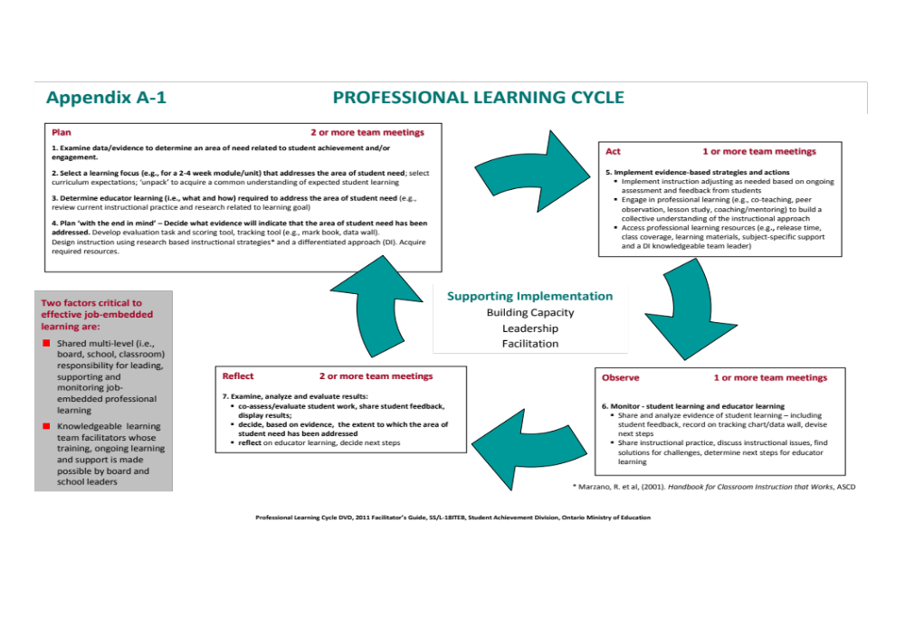

Slide 14
REFLECTION AND IMPROVEMENT
IS A CONTINUOUS CYCLE

Slide 15

WE ARE ONLY HUMAN!

Slide 16


Slide 17
S. M. A. R. T.
GOALS
SPECIFIC
MEASURABLE
ACHIEVABLE
REALISTIC
TIMELY

Slide 18
S. M. A. R. T. GOALS
CAN BE
Personal
Professional
Individual
Team – based
Department – based
School-based
About your teaching
About your career pathway

Slide 19
CAREER PLANNING
Be open-minded!
Talk to other people – colleagues, mentors, family, administration
Try new things
Teach at different schools
Teach different classes and grades
Gain energy from change
See where life takes you
Set goals for yourself, no matter how small or large

Slide 20
MOST IMPORTANTLY:
Write down your goals!
Check them frequently!
Become accountable to yourself!
Kids are worth it!
You are worth it!

Slide 21
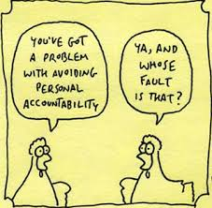

Slide 22

LIKE A FINE WINE, WE WANT TO IMPROVE OVER TIME

Slide 23
Questions?

