Slide 1
EDUCATIONAL LEADERSHIP
Leadership, Mentorship, and Coaching
Au & Associates Education Solutions
Presented by Lindsay McWaters

Slide 2
Leadership,
Mentorship,
Coaching
What’s the difference?

Slide 3
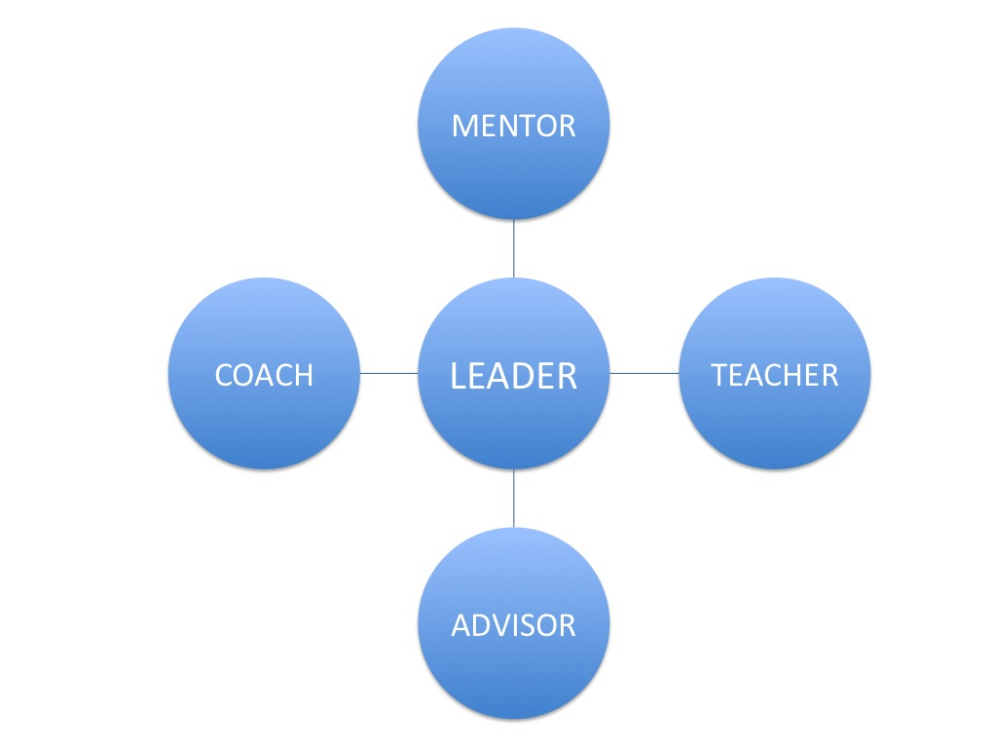

Slide 4
Leading without Title
Robin Sharma
Think big.
Start small.
Begin now.

Slide 5
Types of Leadership

Slide 6
Servant Leaders
Care deeply about people
Remove obstacles in the way of individuals
Motivate people to change and do their best
Not concerned with their own power, fame, or wealth

Slide 7
Primal Leadership
Daniel Goleman

Slide 8
Daniel Goleman’s Leadership Styles
Visionary
Coaching
Affiliative
Democratic
Pacesetting
Commanding

Slide 9
Visionary Leaders…
Promote change through their passion and commitment
Inspire hope for a better future
Positive attitude motivates people
Explain WHY it is important to act and change
Good when a positive direction or a change is needed

Slide 10
Coaching Leaders…
Connect people with the organization’s goals
Highly Positive
Help to develop and improve others
Communicate belief in people

Slide 11
Affiliative Leaders…
Create harmony by connecting people
Help to motivate during tough times
Have a positive impact on climate and culture
Can improve communication, raise morale, or repair broken trust

Slide 12
Democratic Leaders…
Value the input and feedback of others
Acquire commitment through participation
Build on collaboration, team work, conflict management, influence
Good at listening, being empathetic

Slide 13
Pacesetting Leaders…
Meet challenging and exciting goals
Take initiative
Are good when there is a need for strong results from a very strong team
Can have a negative influence if poorly executed
Use this approach sparingly!

Slide 14
Commanding Leaders…
“Do it because I said to do it”
Take control and give clear directions
Can be calming to some people, especially in an emergency
Usually only effective during an emergency or with problematic employees
Use this approach sparingly!

Slide 15

The key is to use a balanced variety depending on circumstances

Slide 16
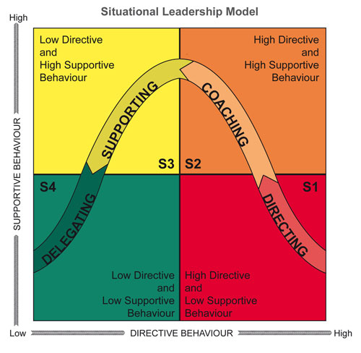
Situational Leaders
Paul Hersey
Diagnose the circumstances
Look at the team members
Adapt their own behaviour
Communicate with teams
Manage change
Are flexible!

Slide 17

Do not under-estimate the power of emotional intelligence!
EQ + IQ = Good Leader

Slide 18
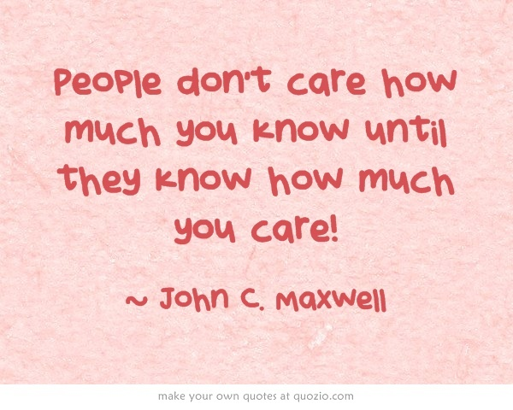
Whatever type of leadership you employ, remember:

Slide 19
Activity
Case studies:
    Which leadership style(s) would work best?
    What steps will you take to handle it?

Slide 20
Questions
& next steps

