Slide 1
“THE BEST THING SINCE SLICED BREAD”
Looking at School Systems, Current Methodologies, and Terminologies in Education
AU & ASSOCIATES EDUCATION SOLUTIONS
PRESENTED BY LINDSAY MCWATERS

Slide 2
“Teacher, Know Thy Learner!”
Learning Styles & Multiple Intelligences
Perform Diagnostic Assessment
Activate prior learning
Special Needs, language acquisition
At-Risk factors
Build relationships

Slide 3
Okay…got it...
now how do I teach them all ?!?

Slide 4
Curriculum and Planning
Backwards Design
Bloom’s Taxonomy
Critical Thinking
Professional Learning Community

Slide 5
Backwards Design
To begin with the end in mind means to start with a clear understanding of your destination. It means to know where you're going so that you better understand where you are now so that the steps you take are always in the right direction.
—Stephen R. Covey, The Seven Habits of Highly Effective People

Slide 6
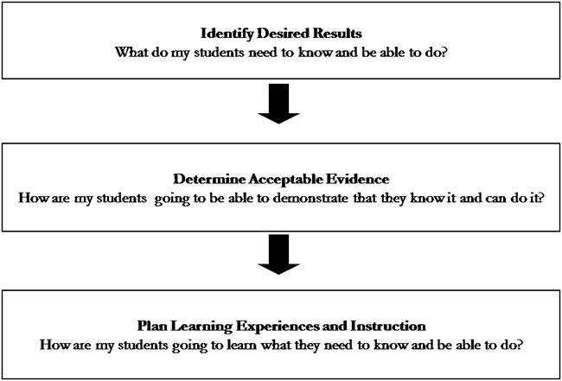

Slide 7
How Do I Use Bloom’s Taxonomy?
Organize objectives
Create good questions
Design rich tasks
Get students thinking, doing, and caring

Slide 8
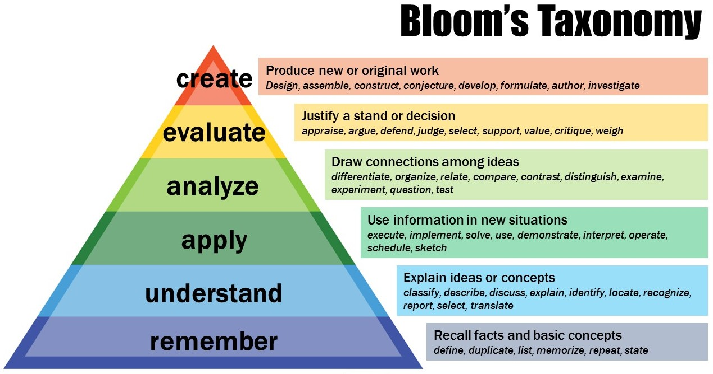

Slide 9
Critical Thinking
What is it?
Why is it important?
How do I use this approach?

Slide 10

Critical Thinking
Let’s get our students thinking!
GGN Clip

Slide 11
Professional Learning Communities
Work with other teachers
You have hundreds of experts, mentors, and teachers in your school!
Create goals, tasks, and assessments together
Mark tests, quizzes, and projects together

Slide 12
PLC – Guiding Questions
What do we want students to learn?
How will we know when they have learned it?
How will we respond if some don’t learn it ?
How will we respond if some already know it?

Slide 13
Activity
Instructional Strategies
Classroom Structures
Instructional Tools

Slide 14
Instructional Strategies
Direct vs. Indirect Instruction
Scaffolding
Gradual Release of Responsibility Model
Differentiated Instruction & Assessment
Evidence-Based Instructional Strategies

Slide 15
Classroom Structures
Interactive Instruction
Learning Centres
Experiential Learning
Cooperative Learning
Independent Study
Flipped Classroom
Blended Learning vs. e-learning

Slide 16
Instructional Tools
Smart Boards
Smartphones
Clickers
Computers
Anchor Charts
Graphic Organizers, Concept Maps
Three Part Lessons (Minds On, Action, Consolidation)

Slide 17
Assessment & Evaluation
Success Criteria: Teacher Created or Co-Created?
Assessment of, as, and for learning
Descriptive Feedback
Formative vs. Summative Assessment

Slide 18
Success Criteria
What is it?
How do we do it?

Slide 19
Assessment
FOR Learning
AS Learning
OF Learning
= Diagnostic
= Formative
= Summative

Slide 20
Feedback
information about how we are doing in our efforts to reach a goal

Slide 21
Effective Feedback is NOT:
Praise
Advice
A letter or a number
A check mark
Evaluative

Slide 22
Effective Feedback is:
Connected to the learning goal
Clear and Specific
Meaningful
Achievable
Timely
Ongoing, consistent
Descriptive

Slide 23
STEM VS. STEAM
STEM (Science, Technology, Engineering, Math)
STEAM (Science, Technology, Engineering, Arts, Math)
Establish relevance and emphasize 21ST Century Learning Skills to challenge students in a variety of instructional and assessment strategies

Slide 24
Activity
Post-it
Feedback

