Slide 1
“THE BEST THING SINCE SLICED BREAD”
Looking at School Systems, Current Methodologies, and Terminologies in Education
AU & ASSOCIATES EDUCATION SOLUTIONS
PRESENTED BY LINDSAY MCWATERS

Slide 2
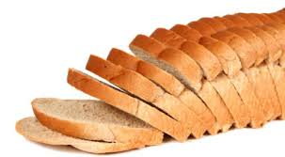
“THE BEST THING SINCE SLICED BREAD”
IDIOM

Slide 3
SCHOOL SYSTEMS
School Structures
Student Life
Teacher Life
Assessment and Evaluation

Slide 4
KNOWING THE LEARNER
Learning Styles & Multiple Intelligences
Diagnostic Assessment
Activation of prior learning

Slide 5
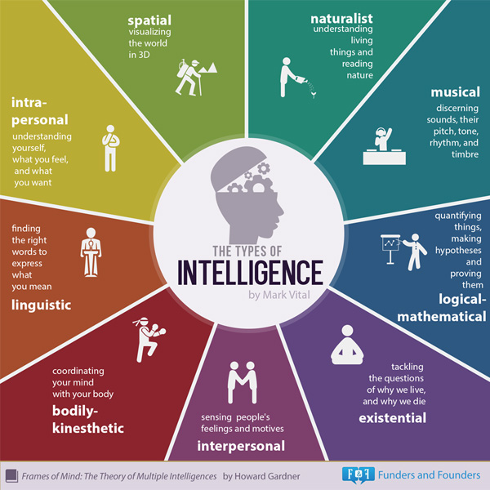

Slide 6
KNOWING THE LEARNER
At-Risk Students
Special Education
Individual Education Plans
ESL / ELL

Slide 7
At-Risk Students MAY…
Have difficulty passing their classes
Have learning difficulties or face challenges in meeting standards
Have difficulty with transitions
Have social or emotional needs
Have family or economic needs
Have difficulties attending school regularly
Be disengaged from school

Slide 8
Special Education Students in Ontario…
Have special needs
Require more support than most students
May have behavioural, communicational, intellectual, physical challenges (or a combination)
May be academically superior to their peers
May also be considered at-risk in some cases
May be identified as ‘exceptional’ if they meet the Provincial criteria

Slide 9
Individual Education Plan
In Ontario, it is the law!
Tailored to the needs of the individual learner and their specific diagnosis
Outlines very specific supports and accommodations
Revised at least twice a year with parent input
Varies greatly from student to student

Slide 10
Special Accommodation and Support in:
Transitions
Teaching methods and strategies
School/Classroom setting
Assessment and evaluation
Required, not optional

Slide 11
ESL vs. ELL
English as as Second Language Learner
English Language Learner

Slide 12
Get to Know Your Learner:
Consider Learning Styles & Multiple Intelligences
Consider various contributing factors and special needs
Perform Diagnostic Assessments and Activate prior learning
Find out about their interests, hobbies, and backgrounds
It will make your job easier!

Slide 13
Questions?

