Slide 1

The Ball is in YOUR Court
Re-imAgining Lessons
By Amy Scholl, Au and Associates, july 2016

Slide 2
Let’s REVIEW!
In groups of 4 or 5, look at the items in the concept circle. Decide on a 4th concept to add to your discussion. You may choose a concept that struck you as important throughout the week, or one that you need to discuss in more depth.
Consider the connections and disconnections between and among each of the items in the concept circle. Discuss them in your groups. Discuss how they apply to your classroom. How do the items fit together?
Write down your reflections.

Slide 3
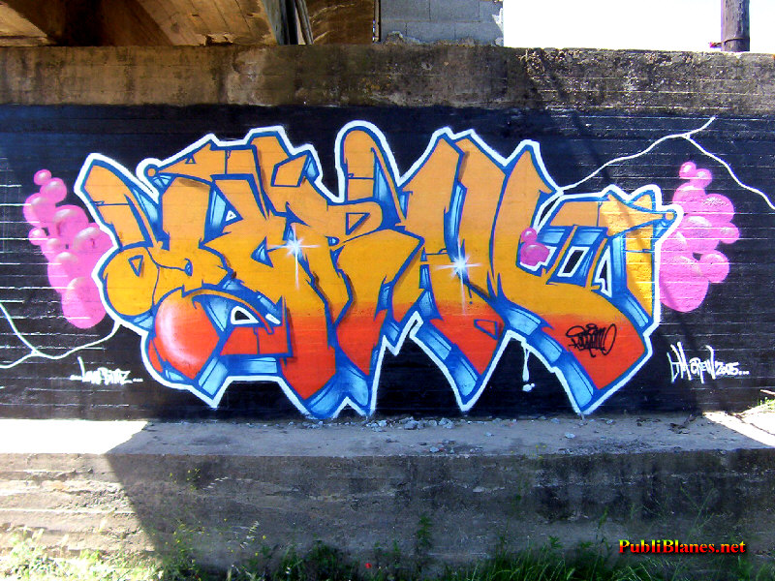
Let’s REVIEW MORE!
Complete the graffiti activity that is set up around the room.
You’ll need a marker and your reflections on the week.
After the first station, read what others have written and add to it what you can.
There are a variety of categories. Make sure you read each title carefully.
You will have approximately 1.5 minutes at each station.

Slide 4

NOW IT’S YOUR TURN
Abraham Lincoln once said, “I am a slow walker, but I never walk back.”
Change must happen slowly and in small bits to really work for all parties.
Let’s see how we can make small changes to improve our teaching practice.

Slide 5
NOW IT’S YOUR TURN: You have 60 minutes
Get into groups of 3 or 4.
Let’s start by reflecting on a lesson that works! What works about it? What might need some change? Share these observations with your group.
Decide on one lesson that you’d all like to work on re-imagining together.
Please keep in mind that you’ll eventually be presenting this lesson to your colleagues.
Use the resources provided by our team: The Three Part Lesson Plan, Differentiated Instruction handout, High Yield Strategies handout, and all the learning from the week: reading, writing, oral communication strategies, collaborative learning, gradual release of responsibility, etc.
And complete the lesson plan template to devise your lesson.

Slide 6
Presentation Time
Now it’s time to devise a creative way to present your lesson plan…
COMPLETE THIS SLIDE DURING THE WEEK

