Slide 1
“The Best of Both Worlds”
Using Technology to Improve Writing
Au & Associates Education Solutions
Presented by Lindsay McWaters

Slide 2
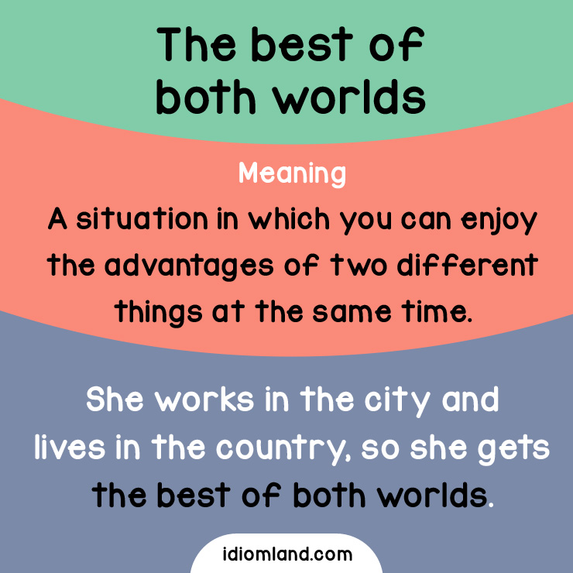

Slide 3
WHY
on earth
would we do that?

Slide 4
Common Reasons why teachers do not use more technology in their classrooms
We do not want to spend time learning technology or changing their teaching practices
Lack of technical support or resources at school
Concerns about privacy or security
Inability to access many sites due to firewalls/site blocking
“Students are better/quicker at this than me”

Slide 5
BENEFITS FOR STUDENTS:
Prepares students for the future
Provides wider access to more resources
Improves skills
Increases student collaboration
Helps students learn at their own pace, in their own learning styles
Can increase motivation and self esteem

Slide 6
BENEFITS FOR TEACHERS
Helps us connect with students
Helps us to connect students with content
Keeps students engaged and focused for longer periods of time
Helps us to differentiate instruction and address learning styles
Move the focus from ‘us’ to ‘them’
Provides wider access to more resources
Makes record-keeping easier/more efficient

Slide 7
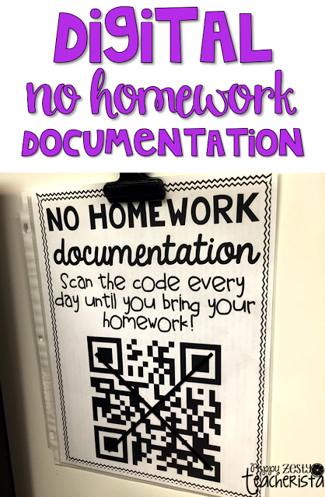

Slide 8
WHY on earth
WOULDN’T we do that?

Slide 9
LAY THE GROUND WORK FIRST
Do some research and experimentation
Talk to colleagues and mentors
Educate colleagues, parents, school administration
Work with students to create expectations around academic honesty, appropriateness, multi-tasking
Strike a balance

Slide 10
APPROACHES
Use of computer labs in school
Use of mobile labs in school
Flipped learning
Blended learning
E-learning
Moodles/online forums/websites/applications

Slide 11
TOOLS
Docu-cameras
Computers
iPads/Tablets
Smartphones
Clickers
Smart Boards
Laptops/netbooks
QR CODES

Slide 12
Activities
KWL CHARTS
SHARING

